Slide 1
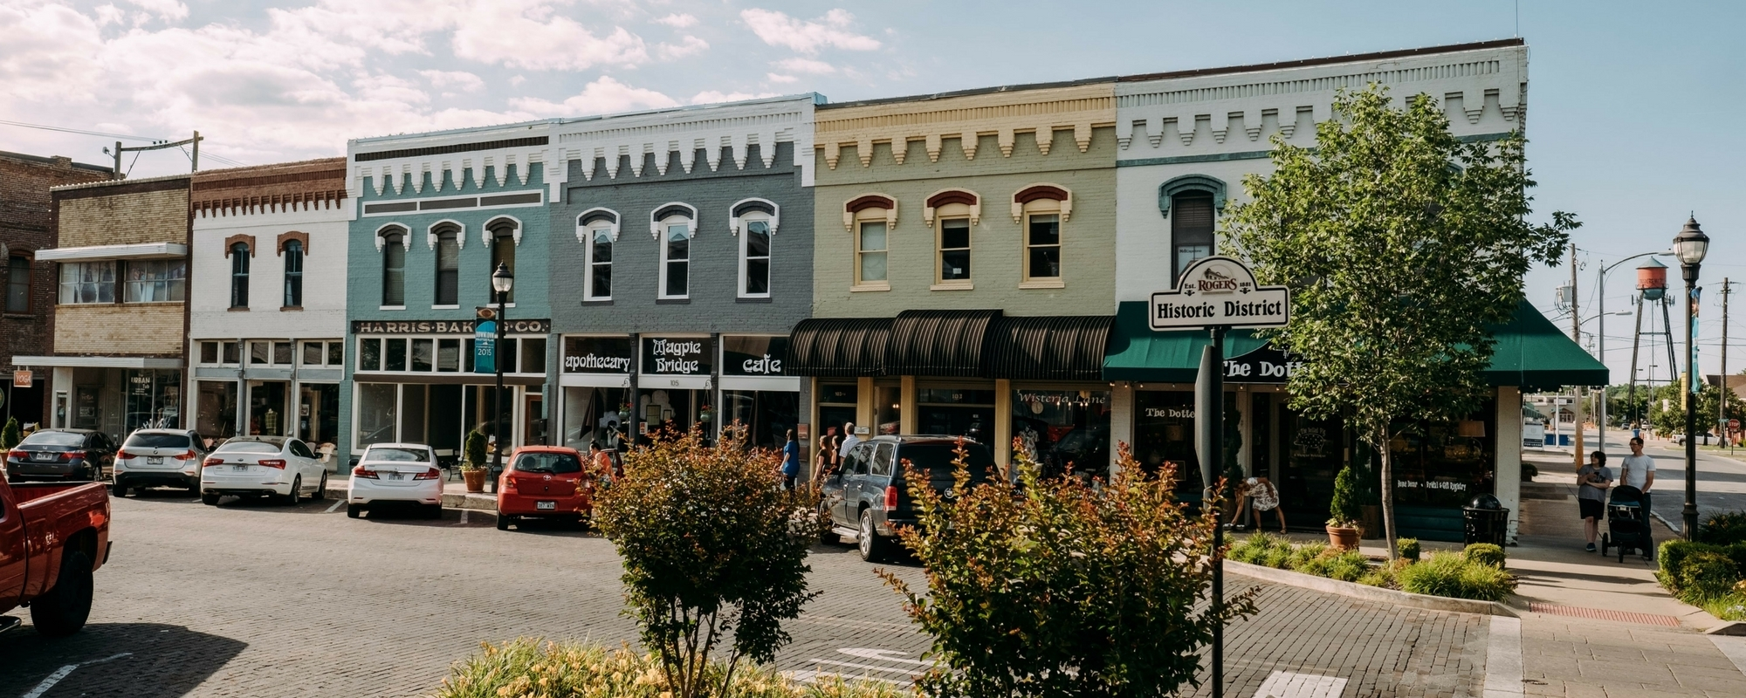
Northwest Arkansas
Real Estate Market Study
Francis Morales
Data Science Program - Flatiron School

Slide 2
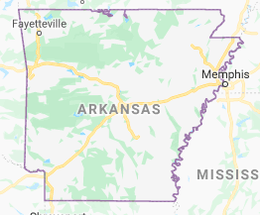

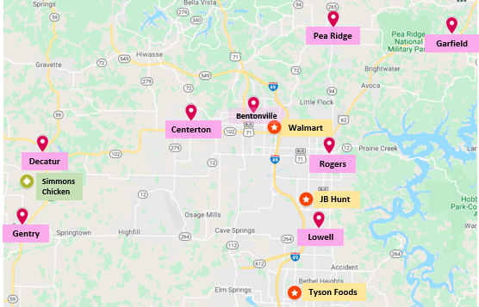

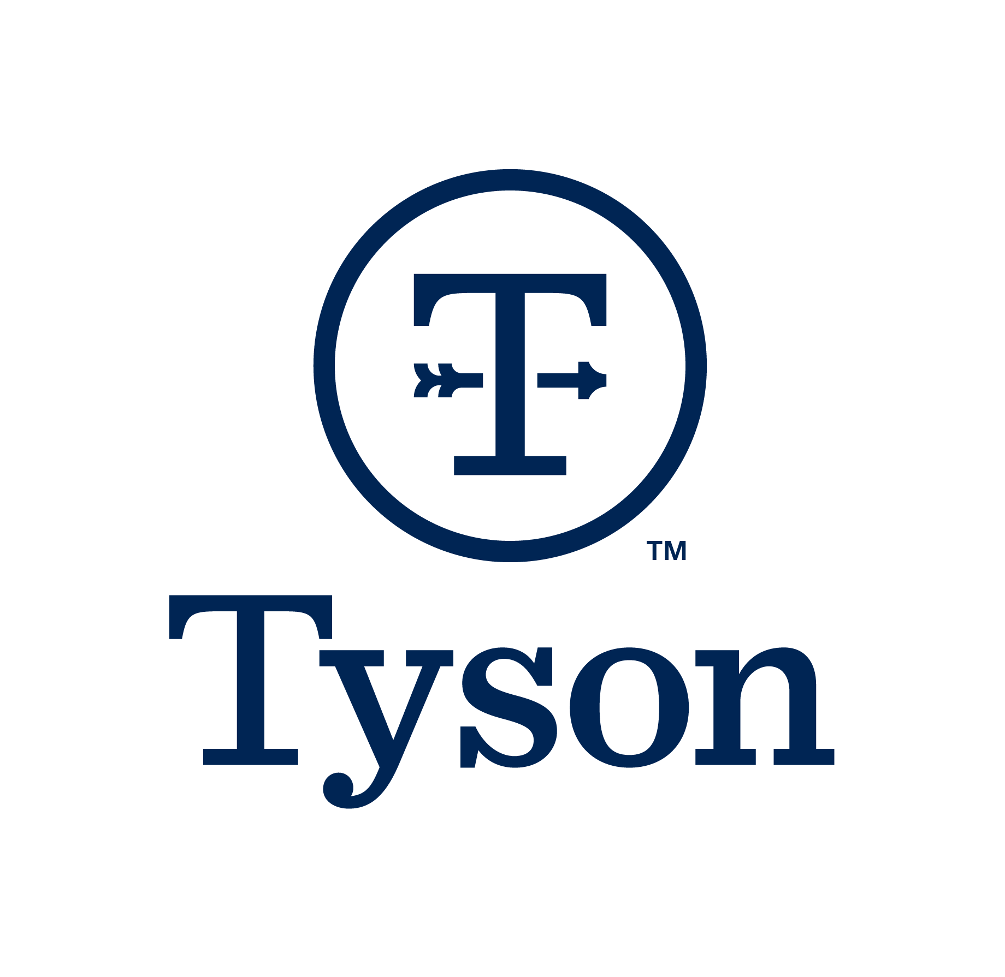

Northwest Arkansas
Cities under Study*
Bentonville
Centerton
Decatur
Garfield
Gentry
Lowell
Rogers
Pea Ridge
#4 Best Affordable Places to Live
#6 Nation’s Best Cities for Jobs
#22 Fastest Growing Region
Population: 563,400
Unemployment: 2.7% vs 3.9% US Average
Job growth expected to increase 44% over the next 10 years
Cost of living score: 83.7 vs 100 US Average
Fortune 500 companies based in NWA
Walmart
Tyson Foods
JB Hunt Transport Services
*See Appendix A for details on city selection process
Notes:
Why Northwest Arkansas?
This region has received national recognition for its high quality of life, low cost of living, reduced crime rates and economic vitality.
563400 – current population
2.7% Average annual unemployment rate compared to 3.9% nationwide
Cost of living is cheaper than US average (83.7 compared to 100 National Average)
There are plenty of competitive career opportunities as Northwest Arkansas hosts 3 Fortune 500 headquarters (Walmart, Tyson Foods and JB Hunt Transport Services).
The eight cities marked in the map were selected for this real estate study since they presented a median house price increase of 20% over the last 10 years. They were also selected due to their proximity to the Fortune 500 headquarters.

Slide 3

Business Need
Project Value
Identify the cities/zip codes in Northwest Arkansas that will bring the most ROI with the lowest risk to present to potential NWA investors.
Make the best decision on investments in NWA based on accurate forecasts and environmental data.
Methodology
Use Zillow.com house median price monthly data from 2009-2019 to build a Time Series model.
Data exploration & Visualization
City & Zip Code selection (App A)
Time series modeling
& forecasting
Forecast evaluation
& conclusions

Slide 4
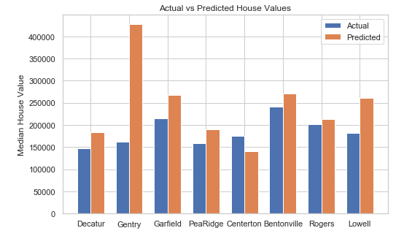
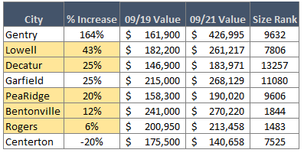
Model Results
4
1
Lowell
43% increase forecasted for the next 2 years
Home of JB Hunt headquarters
Within 10 mile distance from Walmart headquarters
Growing suburb area
2
3
5
Decatur
25% increase forecasted for the next 2 years
1500+ new jobs due to Simmons Foods 2020 Plant
Not many houses available in the area
Good potential for development projects
Pea Ridge
20% increase forecasted for the next 2 years
Within 10 mile distance from Walmart headquarters
Growing suburb area
Bentonville
12% increase forecasted for the next 2 years
Home of Walmart Headquarters
Growing urban area
Rogers
6% increase forecasted for the next 2 years
Within 10 miles from Walmart headquarters
On going infrastructure investment
Biggest growing urban area of the study
1
2
3
4
5
*Further details on time series modeling and its performance for each city can be found in Appendix B
Notes:
Lowell is projected to have the biggest growth of all NWA cities. Its location is strategic, not only because it is the city of the study closest to the three Fortune 500 headquarters, but also because it is 10 miles away from Fayetteville (home of University of Arkansas). It is becoming a favorite area for families to buy a house.
Decatur is projected to have a strong growth within the next 2 years due to the new Simmons Foods Plant opening in 2020. This new plant is going to bring more than 1500 jobs and there are very little housing options as of now. Great potential for housing development projects.
Pea Ridge is a growing suburb area. It is becoming a favorite area for Walmart executives looking to buy a house as it is only 20 minutes driving from Walmart Headquarters.
Bentonville is an all time favorite location for locals. The presence of Walmart Headquarters in town has brought all kinds of restaurants and amenities. Young professionals and people looking to live in a more city-like environment are the target for this city.
Rogers is becoming a trendy urban area. The recent infrastructure investments from the local government have brought trendy restaurants and entertainment options to town. Rogers is also big on outdoor activities like mountain biking and lake entertainment. This is the biggest city of the study and it is projected to have a steady growth over the next 2 years.

Slide 5
Future Work
Make a study of all zip codes and cities from Benton and Washington county
Model Rogers zip codes separately (I merged the data for Rogers for this particular study)
Explore subtracting the rolling mean instead of applying log transform to see if model performance increased

Slide 6
Thank You!

Slide 7
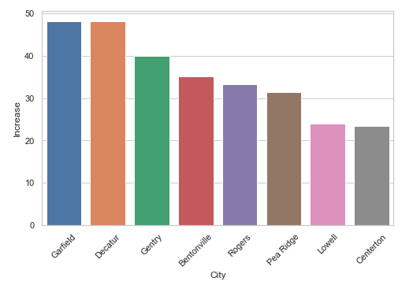
Appendix A
City selection process
For the sake of time and complexity of the study, cities for the study were selected according to below criteria:
Cities from Benton & Washington county
Top 8 cities with price increase over 20% over the last 10 years
Proximity with Fortune 500 headquarters
Fig. House price percentage increase 2009-2019
Fig. Map identifying cities under study and their proximity with Fortune 500 headquarters

Slide 8
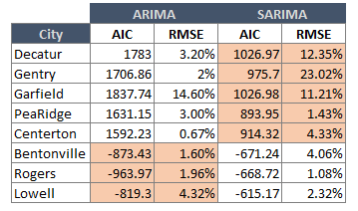
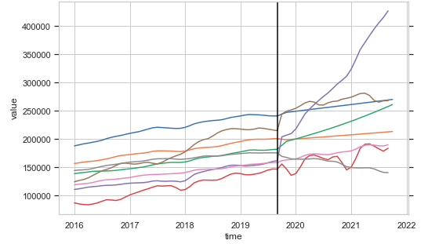
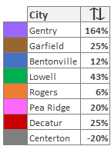
Appendix B
Model performance comparison for ARIMA & SARIMA. In below chart, the model highlighted in orange was the one used for the forecasting for that particular city based on model performance and error.
Fig. Model Performance Comparison ARIMA vs SARIMA
Fig. House Price Forecast

